Slide 1
Year 5 Phasels Wood Trip
Adventure is out there!

Slide 2
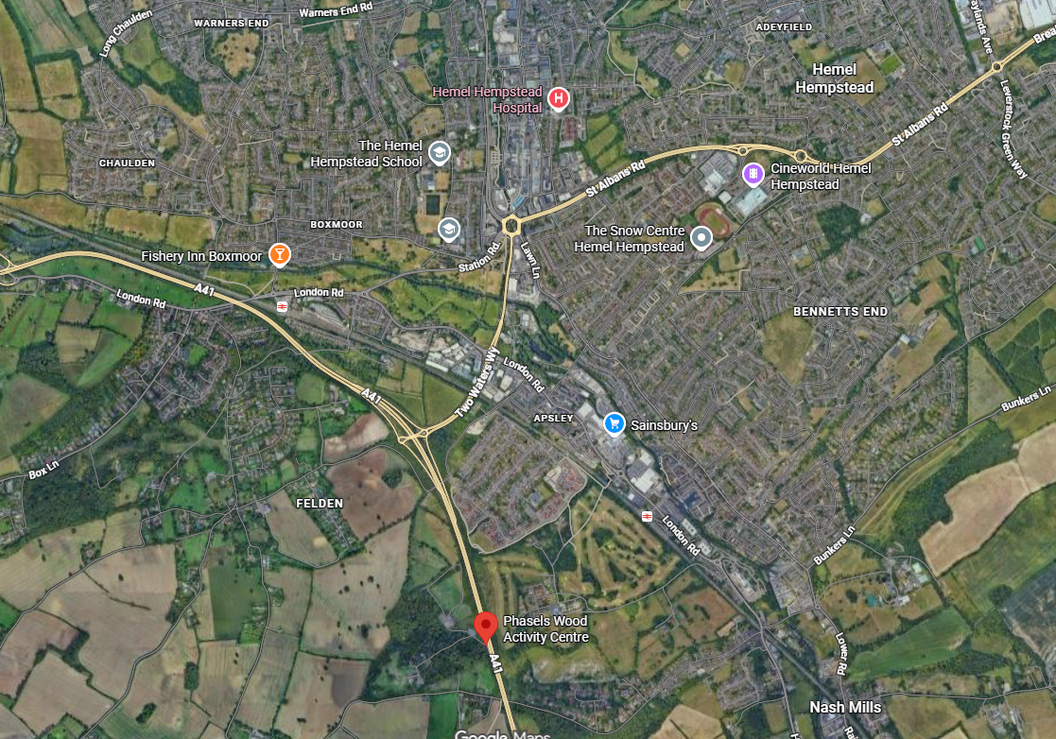
Phasels Wood Activity and Scout Centre

Slide 3
Staff
Miss Noble
Miss Szymkiewicz
Miss Fazli
Miss Varney
Mrs Potts (during the day)
Miss Hammond for Wednesday evening and overnight

Slide 4
Activities
Human Table Football
Shelter Building
Cresta Run
Kayaking (off site - near Nash Mills School)
Land Zorbs
Human Hungry Hippos

Slide 5
Plan
Wednesday 16th September
Parents drop children off at Phasels Wood at 10am
Settle in to lodge
Lunch
Activities in the afternoon

Slide 6
Plan
Thursday 17th September
Activities
Groups will be taken by minibus to the kayaking

Slide 7
Plan
Friday 18th September
Activities
Lunch
Parents collect children at 2pm

Slide 8
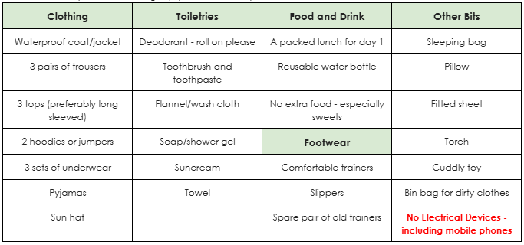
Kit List

Slide 9
Medication
All forms must be completed and returned ASAP.
All medication must be handed to Mrs Potts on arrival at Phasels Wood.

Slide 10
Aims
Team building
Adventure
Fun
Resilience
Responsibility

